Slide 1


Capstone Project:
Amazon Stock
Rahul Champaneria
Joseph Hawkins
Jonathan Manzano
Aaron Sam
Notes:
TEAM

Slide 2

Objectives
Identify the correlation between the stocks’ “Closing Price” over “Time.”
Identify the correlation between the stocks’ “Purchase Share Volume” over “Time.”
Determine if the “Closing Price” has a connection to the “Purchase Share Volume”.
Notes:
JOSEPH H

Slide 3

Metadata
File Type
ASCII text
MIME File Type
text/plain; charset=us-ascii
Number of Entries
6040
Columns
[ “Date”, “Open”, “Low”, “Close”, “Adj Close”, “Volume” ]
Start Date
January 4th, 1999
End Date
December 30th, 2022
Duration
8761 Days == 24 years & 1 Day
Stock Prices
Lowest: $0.27 on October 1st, 2001
Highest: $188.65 on July 13th, 2021
Trading Volume
Lowest: 17,626,000 shares on December 24th, 2019
Highest: 208,658,400 shares on April 25th, 2007
Notes:
AARON SAM
MIME = Multipurpose Internet Mail Extension. Internet standard that describes the contents of internet files based on their natures and formats.

Slide 4
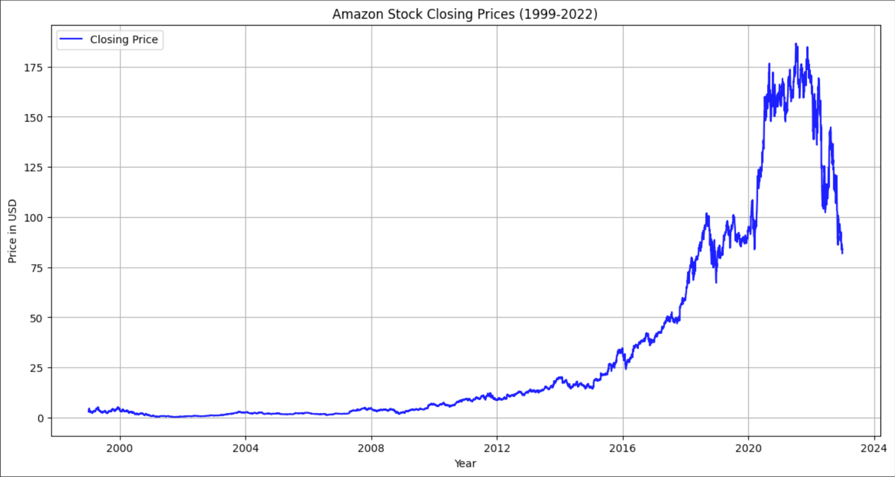

Data Observations
Stock Closing Prices (USD) have Increased over the years
Notes:
AARON SAM
Amazon was not a very well known and used marketplace before 2010. When Amazon finally gained traction in 2010, stock prices began to rise up gradually until it spiked between 2020-2023. There was a massive spike during this time due to the pandemic (or the dark times).

Slide 5
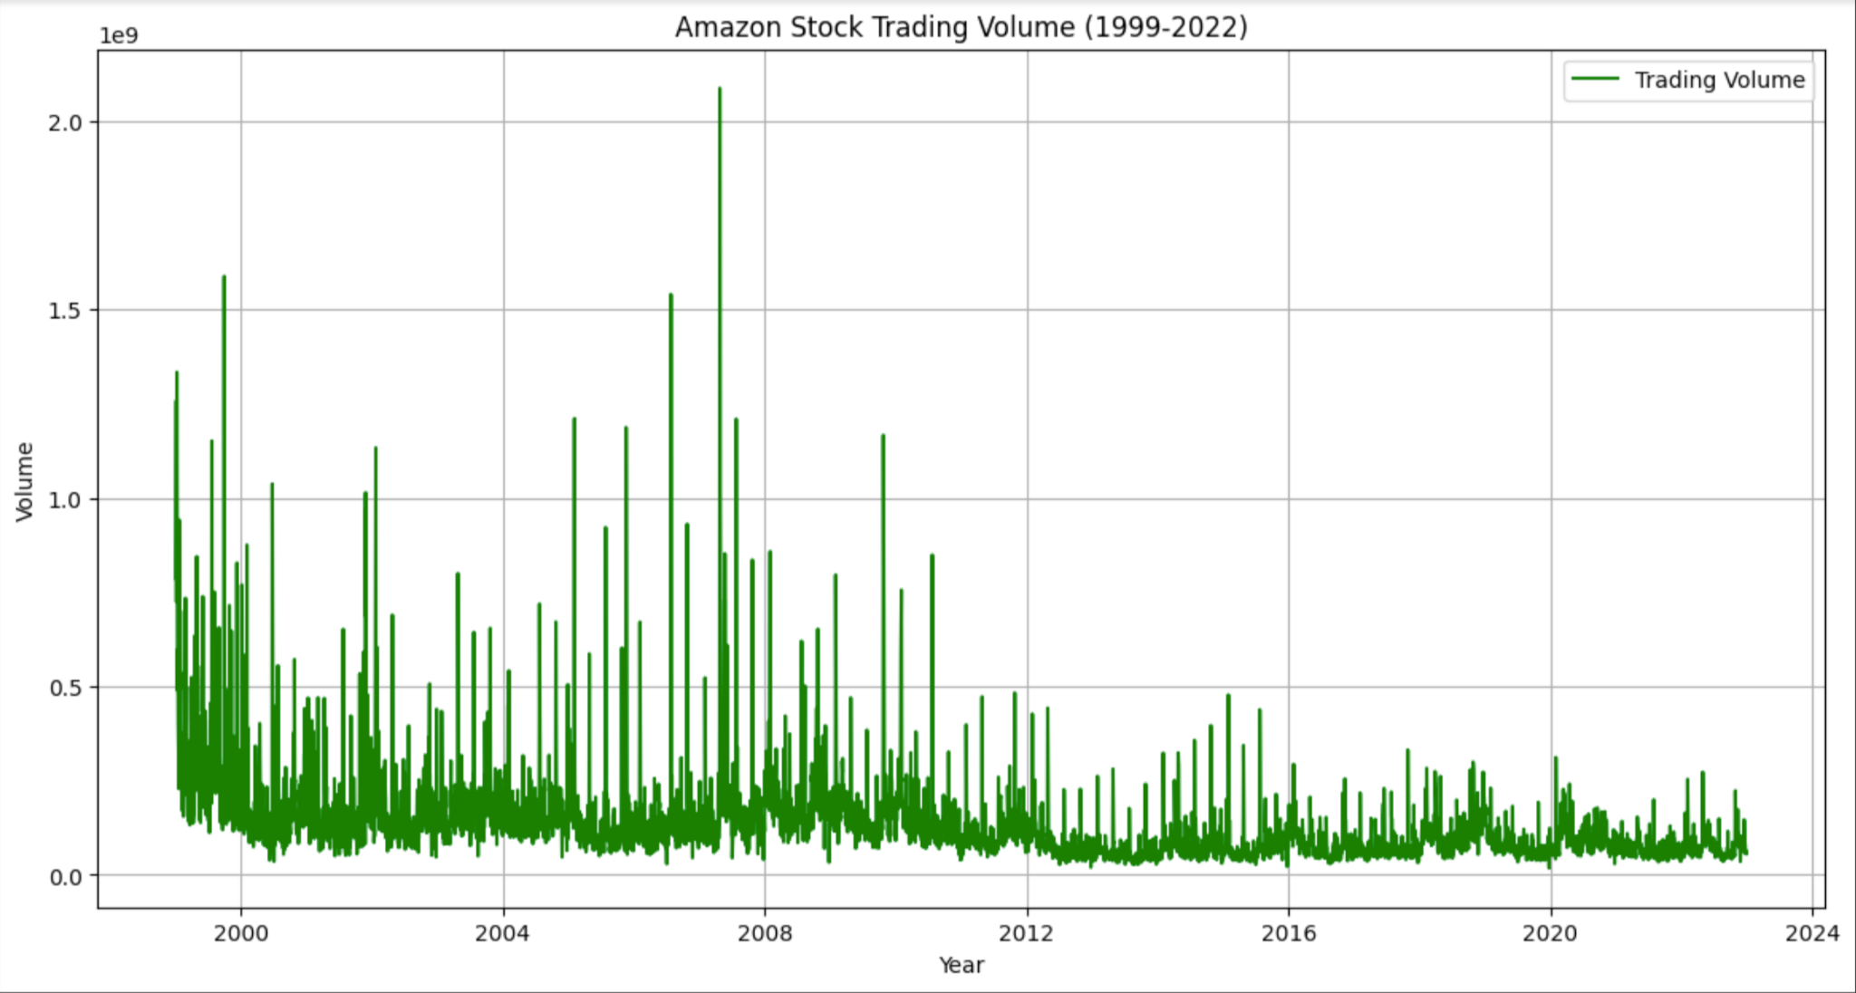

Data Observations
Trading Volume (in billions) was high during 1999-2012
Notes:
RAHUL
Amazon was not a high grossing marketplace that we know it to be today. During the years of 1999-2010, Amazon was a small company and had very cheap stock market prices. However, after 2010, the recession began and the trading volume decreased dramatically, peaking only once during 2016.

Slide 6
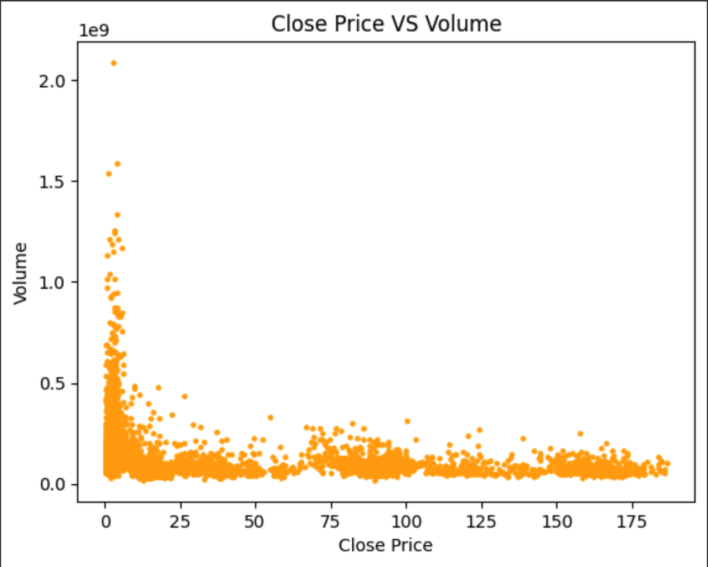

Decoding The Data
Volume (in billions) and Closing Prices (USD) are connected
Reduced Close Prices brings higher stock Volume
Notes:
RAHUL

Slide 7

Tools (Commands)
File Type
$ file AMZN_data_1999_2022.csv
MIME File Type
$ file -i AMZN_data_1999_2022.csv
Numbers of Lines
$ wc -l AMZN_data_1999_2022.csv
Column Names
$ head -1 AMZN_data_1999_2022.csv
Count Non-Null Entries
$ awk -F, '{if (NF == 7) print}' AMZN_data_1999_2022.csv | wc -l
Maximum Volume
$ cut -d, -f7 AMZN_data_1999_2022.csv | sort -nr | head -1
Minimum Volume
$ cut -d, -f7 AMZN_data_1999_2022.csv | sort -n | head -2
Minimum Low Price
$ cut -d, -f4 AMZN_data_1999_2022.csv | sort -n | head -2
Maximum High Price
$ cut -d, -f3 AMZN_data_1999_2022.csv | sort -nr | head -1
Notes:
JONATHAN
Sure! Imagine you have a box of crayons. Each crayon has a label on it, like "Red" or "Blue," so you know what color it is before you use it. In the world of computers, when you send or receive files, like pictures, documents, or music, there's also a kind of "label" that helps the computer understand what type of file it is. This label is called a MIME type.
Just like the label "Red" tells you that the crayon will draw in red color, a MIME type tells the computer if a file is a picture, a video, a document, or something else. This helps the computer to know how to open the file and what program to use. For example, if the MIME type says the file is a picture, the computer knows to open it in a photo viewer.
So, MIME types are like helpful labels for files that tell the computer how to use them!

Slide 8
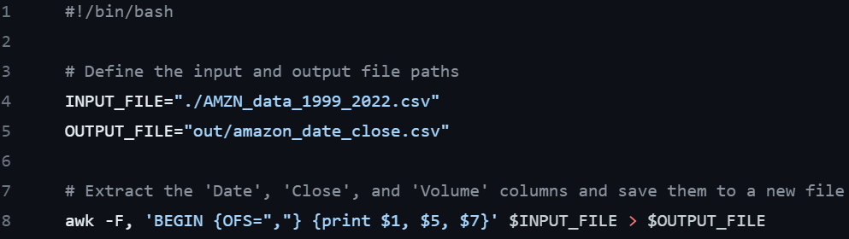
Tools (Commands)
amazon-close-date-volume (script to extract columns: Date, Close, and Volume)
Notes:
JONATHAN

Slide 9

Conclusion
Amazon's journey from an online bookstore to a tech giant is reflected in its stock's remarkable growth over the years, underpinned by strategic diversification, technological innovation, and strong market positioning. ​
Notes:
JOSEPH

